Slide 1

Programming Fundamental
Week 15
Sobia Iftikhar
Sobia.Iftikhar@nu.edu.pk

Slide 2
We’ll Learn Today
1 - Double pointers (basics) 2 - Type casting in pointers (basics) 3 - Pointer to const value 4 - Const pointer to const value 5 - Const pointer to value

Slide 3
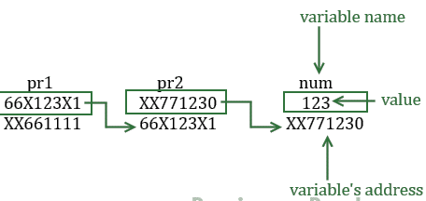
Double Pointer
We already know that a pointer holds the address of another variable of same type. When a pointer holds the address of another pointer then such type of pointer is known as pointer-to-pointer or double pointer.
How to declare a Pointer to Pointer (Double Pointer) in C?
int **pr;

Slide 4
Example
/* Possible ways to find value of variable num*/
printf("\n Value of num is: %d", num);
printf("\n Value of num using pr2 is: %d", *pr2);
printf("\n Value of num using pr1 is: %d", **pr1);
/*Possible ways to find address of num*/
printf("\n Address of num is: %p", &num);
printf("\n Address of num using pr2 is: %p", pr2);
printf("\n Address of num using pr1 is: %p", *pr1);
/*Find value of pointer*/
printf("\n Value of Pointer pr2 is: %p", pr2);
printf("\n Value of Pointer pr2 using pr1 is: %p", *pr1);
/*Ways to find address of pointer*/
printf("\n Address of Pointer pr2 is:%p",&pr2);
printf("\n Address of Pointer pr2 using pr1 is:%p",pr1);
/*Double pointer value and address*/
printf("\n Value of Pointer pr1 is:%p",pr1);
printf("\n Address of Pointer pr1 is:%p",&pr1);
return 0;
}
#include <stdio.h>
int main()
{
int num=123;
//A normal pointer pr2
int *pr2;
//This pointer pr2 is a double pointer
int **pr1;
/* Assigning the address of variable num to the
* pointer pr2
*/
pr2 = &num;
/* Assigning the address of pointer pr2 to the
* pointer-to-pointer pr1
*/
pr1 = &pr2;

Slide 5
Output
Value of num is: 123
Value of num using pr2 is: 123
Value of num using pr1 is: 123
Address of num is: XX771230
Address of num using pr2 is: XX771230
Address of num using pr1 is: XX771230
Value of Pointer pr2 is: XX771230
Value of Pointer pr2 using pr1 is: XX771230
Address of Pointer pr2 is: 66X123X1
Address of Pointer pr2 using pr1 is: 66X123X1
Value of Pointer pr1 is: 66X123X1
Address of Pointer pr1 is: XX661111

Slide 6
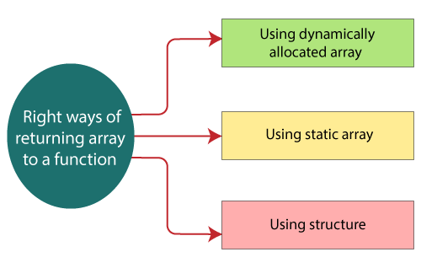
Return array from function
There are three right ways of returning an array to a function:
Using dynamically allocated array
Using static array
Using structure

Slide 7
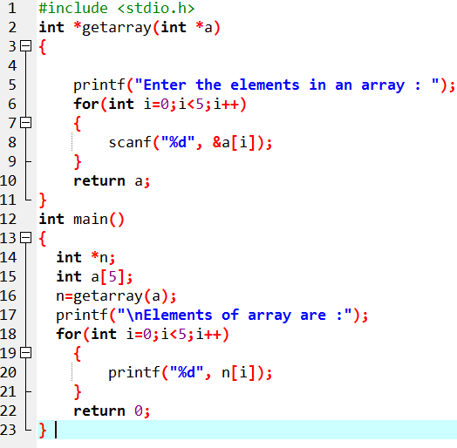
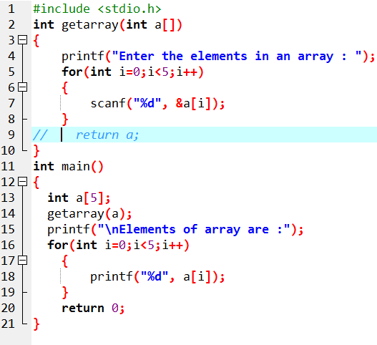
Returning array by passing an array which is to be returned as a parameter to the function.

Slide 8
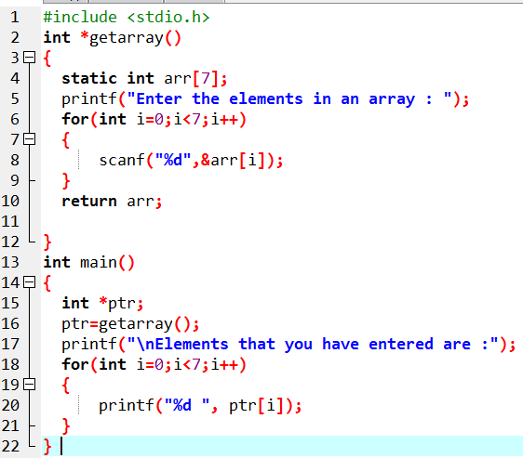
Using Static Variable

Slide 9
Casting Pointers
When assigning a memory address of a variable of one type to a pointer that points to another type it is best to use the cast operator to indicate the cast is intentional (this will remove the warning)
Example:
int V = 101;
float *P = (float *) &V; /* Casts int address to float * */
Removes warning, but is still a somewhat unsafe thing to do

Slide 10
The General (void) Pointer
A void * is considered to be a general pointer
No cast is needed to assign an address to a void * or from a void * to another pointer type
Example:
int V = 101;
void *G = &V; /* No warning */
float *P = G; /* No warning, still not safe */
Certain library functions return void * results (more later)

Slide 11
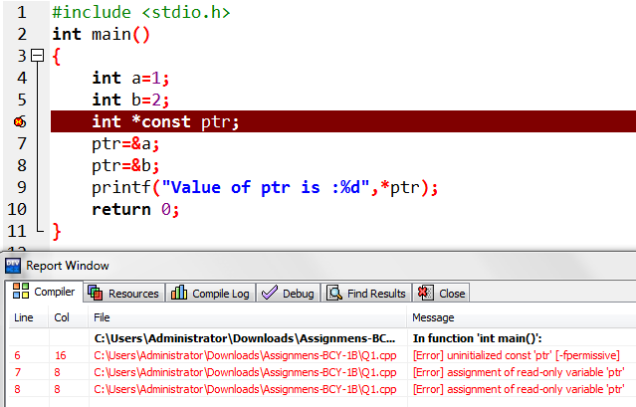
Constant Pointers
A constant pointer in C cannot change the address of the variable to which it is pointing, i.e., the address will remain constant. Therefore, we can say that if a constant pointer is pointing to some variable, then it cannot point to any other variable.

Slide 12
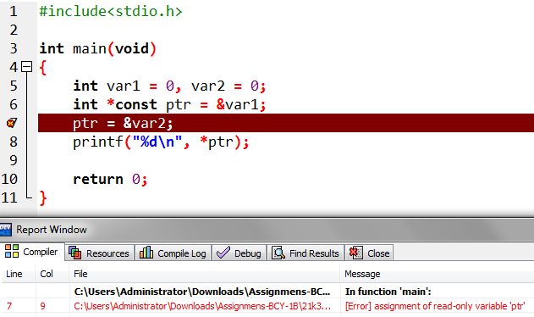


Constant pointer
A constant pointer is a pointer that cannot change the address its holding. In other words, we can say that once a constant pointer points to a variable then it cannot point to any other variable.

Slide 13
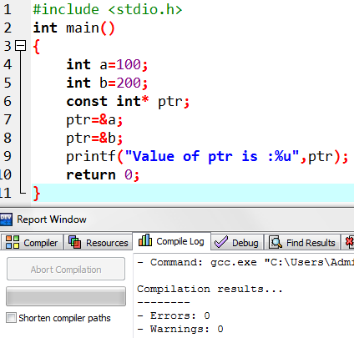
Pointer to const value
A pointer to constant is a pointer through which the value of the variable that the pointer points cannot be changed. The address of these pointers can be changed, but the value of the variable that the pointer points cannot be changed.

Slide 14
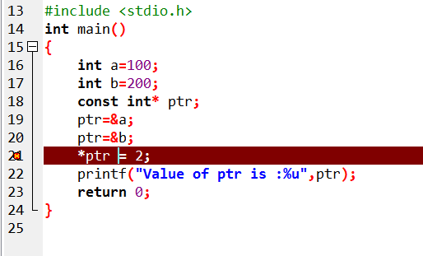

Slide 15
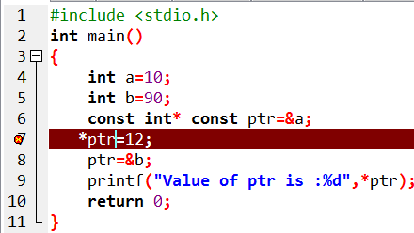
Constant Pointer to a Constant

Slide 16
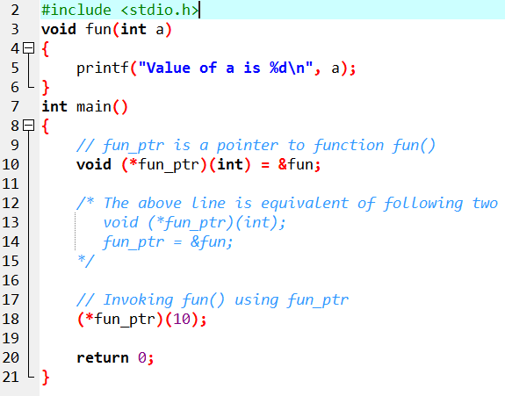
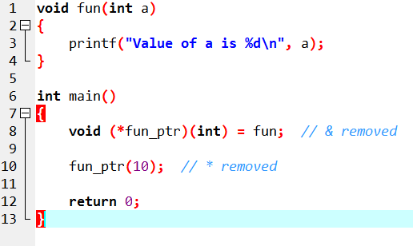
Function pointer

Slide 17
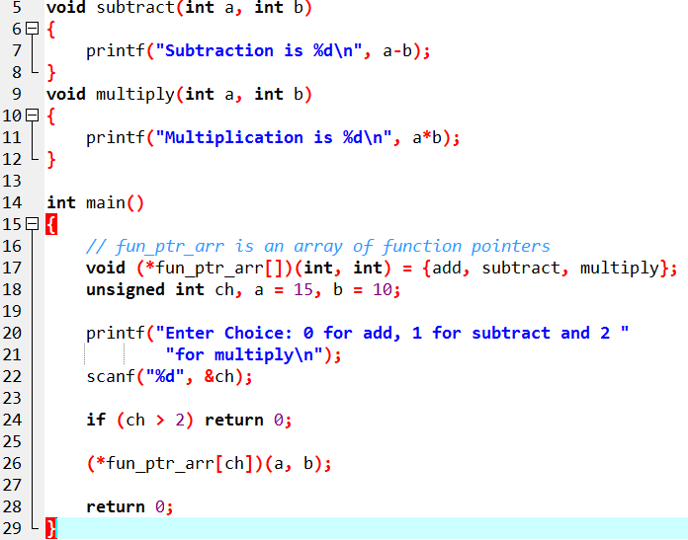
Function pointer

Slide 18
Thankyou

